Slide 1
Consumer Sentiment Analysis of Protein Bars in India
Diana Lionel
MTech Biotechnology

Slide 2
Consumer Sentiment Analysis of Protein Bars in India
Project Objective:
To analyze customer reviews of top protein bar brands in India — The Whole Truth, Yogabar, and RiteBite — to uncover common consumer perceptions, product pain points, and satisfaction drivers, based on actual Amazon reviews.
Data Collection Approach:
Source: Manually copied Amazon customer reviews
Timeframe Considered: Reviews from the past 1–3 years, where available.
Exclusions: Variety packs and unrelated product formats.
Criteria: Focused on individual flavor/variant for brand-specific feedback.
Brands and Variants Analyzed:
Each brand focuses on peanut-based bars:
The Whole Truth – Peanut Cocoa
Yogabar – Peanut Butter
RiteBite – Peanut Butter

Slide 3

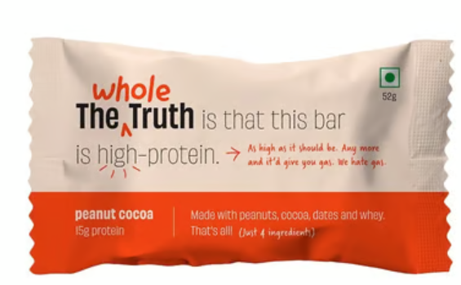
The Whole truth- Peanut Cocoa
I have had many protien bars and many of them had so different chemicals and stuff and not even sure what protien they used. This brand seems to be really committed to provide quality product and I'm all for it. Pricing is promising, packaging and presentation is just great, and feels like home made. I will be purchasing more and more from this brand, hopefully I can see other flavours from their website added on here!
These protein bars are so yummy, i swear they feel like eating peanut flavoured brownies. Not to mention the 100% clean ingredients used in them. So gooood!
Yes, they are quite good, but the price make them impractical for most. Would make a little more sense if they were to give 6 bars at this price. A box of 5 is too little. You are better off buying the best protein powder and mixing it with whatever you love than sticking with bars.
Amazing taste and great packaging done.

Slide 4
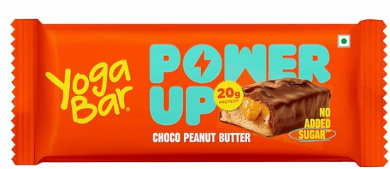
Yoga Bar-Choco Peanut Bar (1/2)
First time ever bought this much tasty and healthy protein bar with content 20g of protein in just one bar that’s unbelievable. Now I take everyday after workout. So fulfilling so tasty so healthy and that also without sugar and in middle of bar you taste tempting peanut butter I feel full for longer time this is now my on go breakfast after workout quality is also very good nice packing worth it
Delicious protein bar It tastes like dessert so it is on the sweeter side Not a lot of peanut butter flavor but I don’t mind.slight artificial vanilla flavor but I personally like it. Really like the crispy soy crisps, they add a great textur
Style I love the idea of protein bars, most are cloyingly sweet, probably to mask the poor taste. This is no exception.

Slide 5
Yoga Bar-Choco Peanut Bar (2/2)
Sorry to give 1 star,actually was hyped with this product and ordered two packs..I found these issues with the product ...its totally My perception .. 1)Maltitol -This literally doesnt digest in your intestines and ferments and generates gas..literally after eating this bar i was suffering with gas for longer time.Asking yogabar to use natural sweetners than these sugar alcohols . 2)i dont know how its a peanut bar not even flavour of peanut i was getting ..its basically like a choco covered wafer and chewy. 3)the bar is not hard not soft but in middle of it and its worse chewy.. Overall 1/5 ..yogabar needs to use different sweetner ..
I had better opinion about Yogabar. This one has hydrogenated vegetable fat as ingredient which is totally avoidable. Also has maltitol which is not healthy sugar substitute. Skip and look for better alternatives

Slide 6
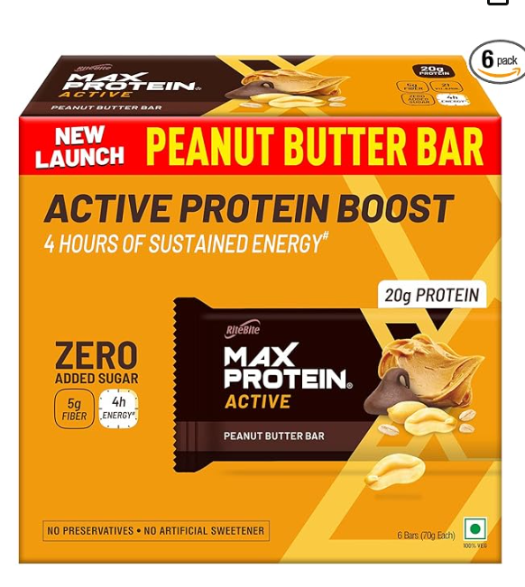
RiteBite- Peanut butter
Definitely keeps me full for at least 3hours. By the time, I finish the bar, I got headache because it’s too hard to chew. I prefer and suggest the 10g protein from the same brand.
I bought this product because I wanted to try Peanut Butter Protein Bar. I have tried lots of of Peanut Butter companies and I thought I should test a Peanut Butter Protein Bar as well. But to my my utter disappointment this is a very bad tasting Protein Bar. The taste is not as near the Peanut Butter taste that you get from an original Peanut Butter.
The bar itself tastes amazing, and really gives you a sense of satiety once you've eaten it. But I think there's an issue with either the protein or the maltitol that's added to the bar because it will make you incredibly gassy and bloated. The flatulence lasts the entire day until your body is done digesting the bar, and it's overall really uncomfortable. If it weren't for the side effects, I would repurchase it, but it's a no go for me.
It is quite rich in protein, but it taste bad and not easy to chew
The taste of this bar is extremely good. The sweet and savoury taste is exemplified with its nutritional benefits. Love RiteBite and their bars.

Slide 7
Key Findings
Common Praise | Common Complaints
Tasty | Expensive
Nice Packaging and Presentation
100% Clean ingredients/ Chemical free
Common Praise | Common Complaints
Satiety | Too Sweet
Tasty | Unhealthy ingredients (hydrogenated vegetable fat, Maltitol)
 | Gas/Bloating
 | Hard to Chew
Common Praise | Common Complaints
Satiety | Some say-Bad Taste
Some say-Good taste | Hard to chew
 | Gas/Bloating

Slide 8
Conclusion
Protein bars in the Indian market serve health-conscious consumers, but texture (chewiness) , excessive sweetness, unhealthy ingredients are frequent issues across brands. Brands like The Whole Truth are praised for their clean label, Packaging but face criticism for being expensive. Yogabar and Ritebite are praised for Satiety however they face criticism for issues like Bloating/Gas, chewiness

